Slide 1
Minimum Spanning Tree
02 May. 2025

Slide 2
Minimum Spanning Tree
Problem: Given a connected, undirected and weighted graph, select a subset of edges such that the graph is still connected, and total weight of the selected edges is minimal.

Slide 3
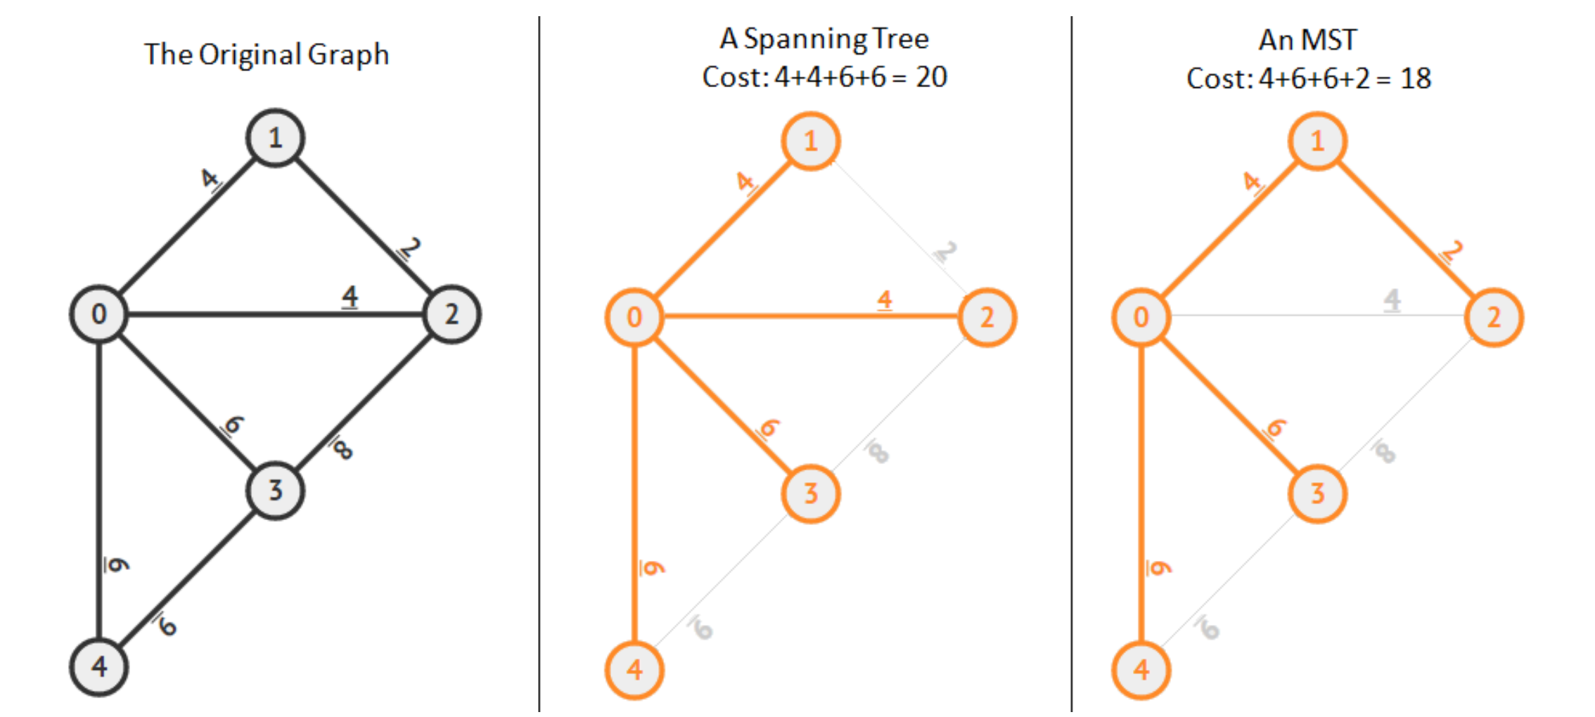
Minimum Spanning Tree

Slide 4
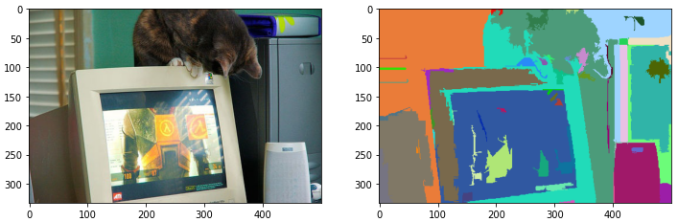
Practical Applications
Network design:
Water/Gas pipelines: Connecting stations using minimal piping.
Computer networks: Connecting a set of computers/routers with the least amount of cable.
Clustering Algorithms:
Used in image segmentation or pattern recognition:
Felzenszwalb-Huttenlocher Algorithm
Available in OpenCV. Can be reached in C++ by cv::ximgproc::segmentation::GraphSegmentation.

Slide 5
Kruskal’s Algorithm
READ graph nodes (V) and edges (E).
SORT edges (E) by their weight.
CREATE Union Find (UF) using the number of nodes.
MinCost: INT = 0
FOR EACH Edge IN E:
IF UF.is_same_set(Edge.From, Edge.To):
CONTINUE
UF.merge(Edge.From, Edge.To)
MinCost += Edge.Cost
PRINT MinCost

Slide 6
Kruskal’s Algorithm - Optimization
READ graph nodes (V) and edges (E).
SORT edges (E) by their weight.
CREATE Union Find (UF) using the number of nodes.
MinCost: INT = 0; NodeCounter: INT = 0;
FOR EACH Edge IN E:
IF UF.is_same_set(Edge.From, Edge.To):
CONTINUE
UF.merge(Edge.From, Edge.To)
MinCost += Edge.Cost; NodeCounter++
IF NodeCounter == (V – 1):
BREAK
PRINT MinCost

Slide 7
Kruskal’s Algorithm - Optimization
READ graph nodes (V) and edges (E).
SORT edges (E) by their weight.
CREATE Union Find (UF) using the number of nodes.
MinCost: INT = 0; NodeCounter: INT = 0;
FOR EACH Edge IN E:
IF UF.is_same_set(Edge.From, Edge.To):
CONTINUE
UF.merge(Edge.From, Edge.To)
MinCost += Edge.Cost; NodeCounter++
IF NodeCounter == (V – 1):
BREAK
PRINT MinCost

Slide 8
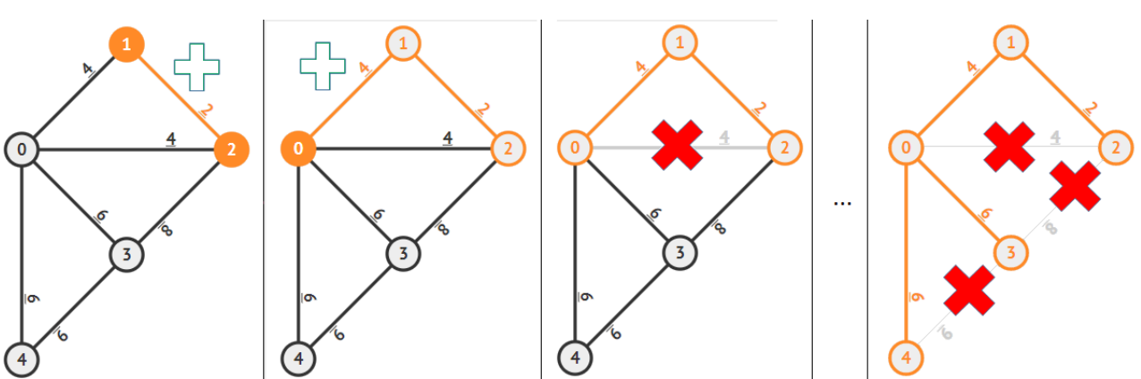
Kruskal’s Algorithm - Animation

Slide 9

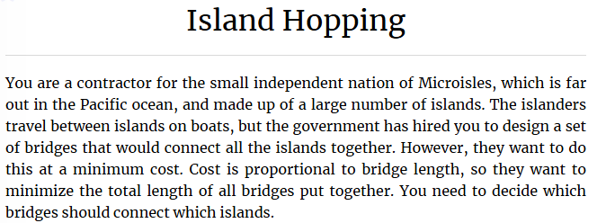
MST – Practice. Island Shopping
Kattis. Island Shopping – Link

Slide 10

MST – Practice. Island Shopping
Kattis. Island Shopping – Link
Hints:
Today’s topic of course:
Union Find (Disjoint Set).
Kruskal’s Algorithm.
Euclidean distance – Link

Slide 11
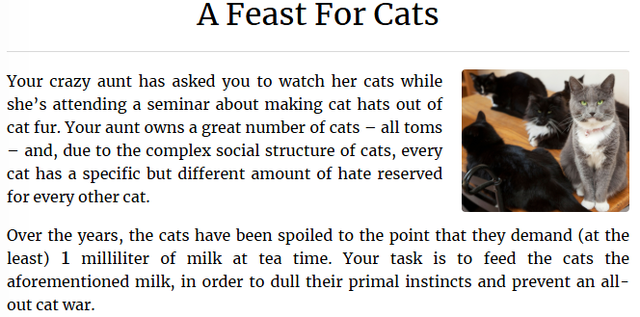
MST – Practice. A Feast For Cats
Kattis. A Feast For Cats – Link

Slide 12
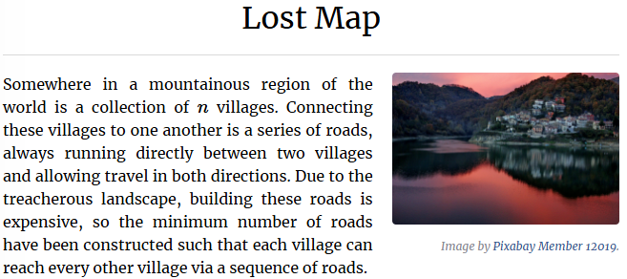
MST – Practice. Lost Map
Kattis. Lost Map – Link

Slide 13
Why Configuration Cin and Cout Matters?
As a reference use task solved before – Kattis. Lost Map – Link
Trivial input output operations might consume a lot of time due internal synchronization and safety checks.
Disable synchronization between streams in C (printf, scanf) and in C++ (cin, cout):
ios_base::sync_with_stdio(false);
Disable synchronization of std::cin with std::cout (do not flush cin when read from cout).
cin.tie(NULL);
Disable synchronization of std::cout with any other possible functionality:
cout.tie(NULL);

